Slide 1

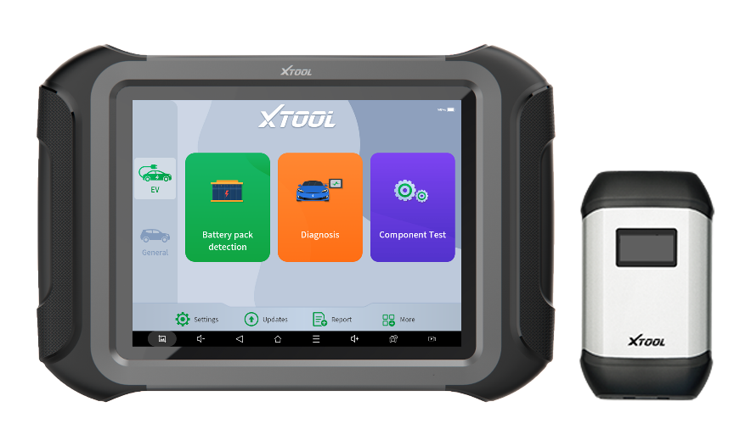
PRODUCT
TRAINING
2022-10-27
2024
N9EV SMART DIAGNOSTIC SYSTEM
Product Training
Basic executive training

Slide 2
Context
Catalogues
01
03
Introduction
Functions
A brief introduction to AD20 and AD20 Pro.
List all the functions that are supported by AD20 and AD20 Pro.
02
04
Parameters
Packing List
The parameters for this OBD dongle.
Answers to some of the common questions.
Basic executive training

Slide 3

PRODUCT
TRAINING
2022-10-27
01
Introduction
Basic executive training

Slide 4
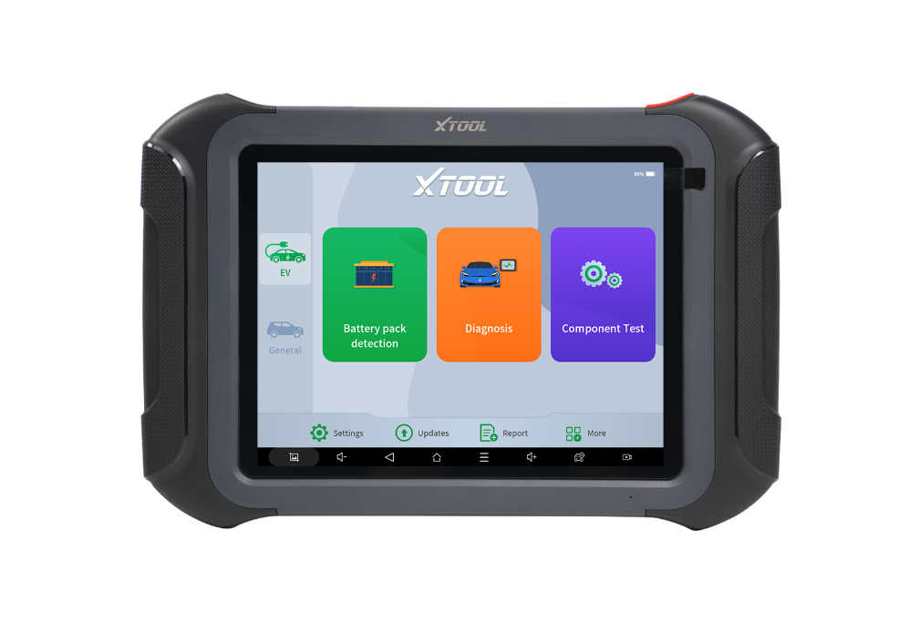
PART-01
Introduction
01
Professional diagnostic tool, covering electric, gasoline and diesel, and hybrid vehicles in the U.S., Europe and Asia
Designed for mechanics, electricians and automotive repair stores, support dynamic testing for battery pack, user can check voltage and temperature of each cell, it also supports off-vehicle drive test of component, including air conditioning compressor, DCDC, OBC.
02
03
42 common special functions are supported, such as throttle matching, ABS bleed, maintenance light reset, EPB test, SAS, BMS, injector coding, DPF regeneration, and TPMS reset. 98% vehicle coverage, work on more than 85 brands, 10000 cars.
Basic executive training

Slide 5

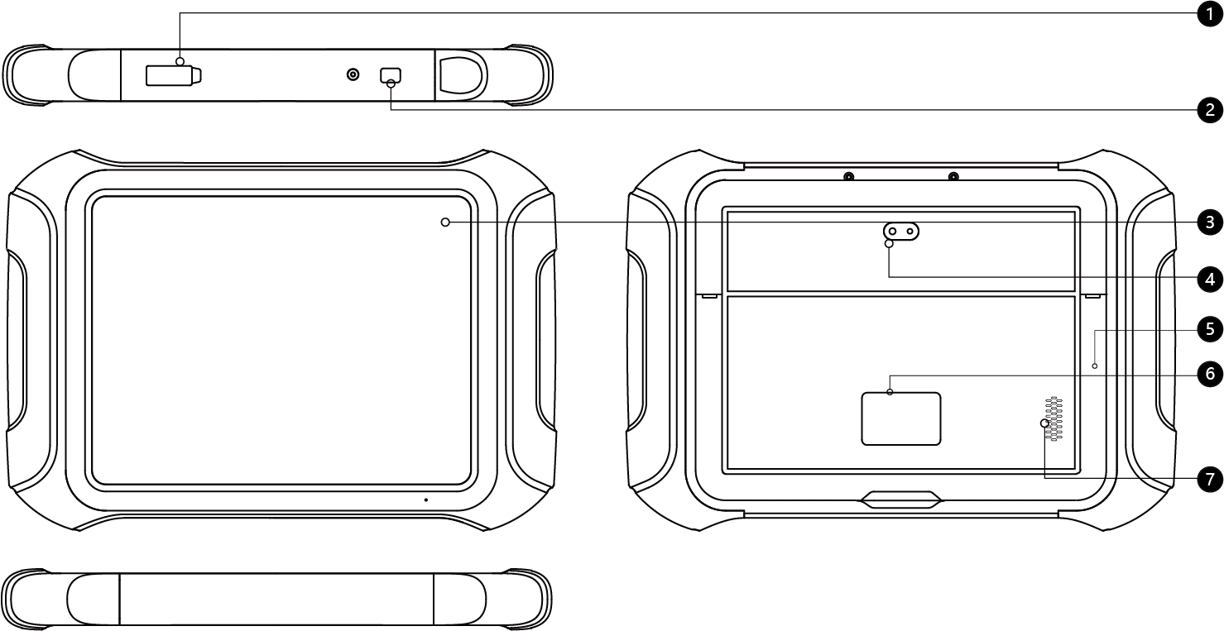
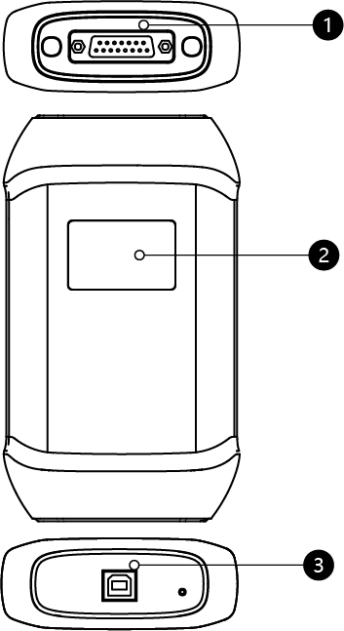
PART-01
Introduction
Tablet
VCI
Type-C
Power Button
9.7 inch LCD
Camera
Holder
Nameplate
Speaker
DB15 Port
Display
Type-B Port

Slide 6
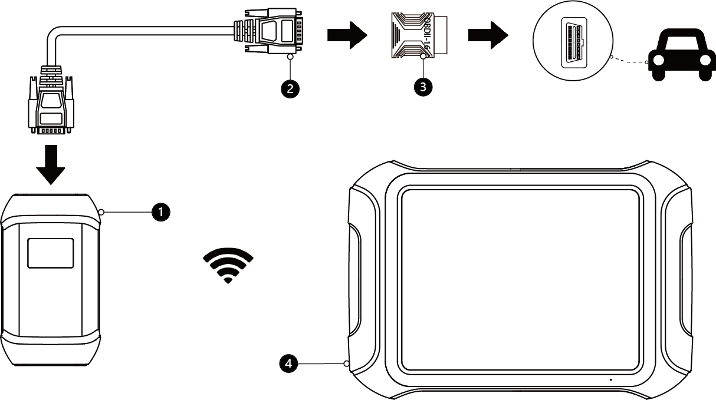
PART-01
Introduction
Wi-Fi connection
01
Wi-Fi communication is normally used when performing general diagnostic function.
Attach the VCI box to the OBD port of the vehicle and make sure it is in good condition. Power on the diagnostic tool and start the diagnostic software, scan tool will automatically connect the VCI box
NOTE：For some old cars with non-standard OBDII-16 port, please confirm the type of OBD port and purchase the OBDI adapter separately for diagnostic.
V207 VCI Box
DB15 Main cable
OBDII-16 Adapter
P902 Tablet

Slide 7
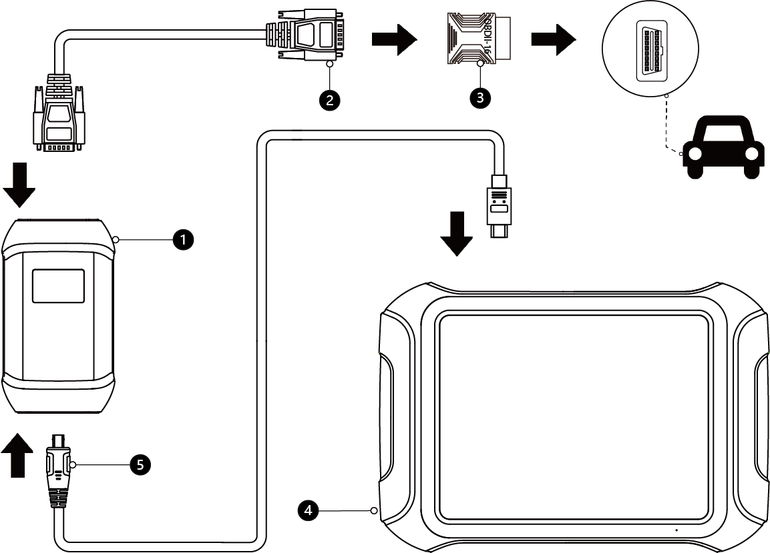
PART-01
Introduction
Wire connection
01
When using functions such as ECU programming & coding, please use the TYPE-B to TYPE-C data cable to connect the tablet to the VCI box to prevent functions from failure due to unstable data transfer, which could cause vehicle malfunction or damage.
V207 VCI
DB15 Main cable
OBDII-16 Adapter
P902 Tablet
Type-B to Type-C data cable

Slide 8
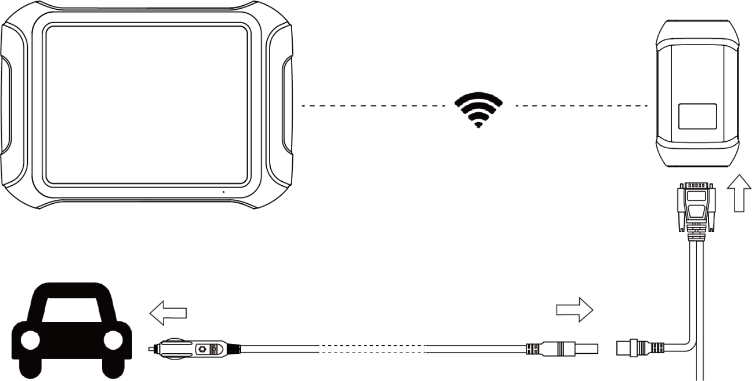
PART-01
Introduction
Self test
①
②
01
The main purpose of the self-test is to determine if there is a hardware failure within the device.
When performing this function, please do not connect the VCI box or tablet directly to the vehicle, as this may cause irreversible damage!
③
④
P902 Tablet
V207 VCI Box
DB15 Main cable
Cigar Ligter

Slide 9
PART-01
Introduction
OE-Level Diagnostic for Tesla
Battery Pack Detection for EV
OEM-level diagnostics for TESLA. Comes with three dedicated test connectors. Support DTC Reading/Clearing, Data streaming, Bi-directional Control and Special Functions.
Supports monitoring the voltage and temperature for battery cell. Works with over 50 different vehicle brands. Unsupported models can be added by CAN detection function (Contact XTOOL TECH).
01
02
Online Coding & Programming
Component Test (off-vehicle)
Provides fault code guidance for VAG and BMW. Supports offline programming for Ford, Lincoln and Mazda; Online coding & programming for VAG BMW and Mercedes-Benz.
Supports off-vehicle drive test of component, including compressor, DCDC, OBC and 48V motor. There is no need to put the components back on the vehicle after completing the repair. Use jumper cables to connect the assembly to the VCI for off-vehicle actuation to confirm the repair.
03
04
Basic executive training

Slide 10

PRODUCT
TRAINING
2022-10-27
02
Parameters
Basic executive training

Slide 11
PART-02
Parameters
Operating System
Communication Method
Android 10.0
Wi-Fi, Wired
Processor
Connectivity
4 Core 1.50GHz
Type-
Memory
Working Voltage
4G+128G
9-36V
Display
Battery
9.7-inch, 1024×768P
6400 mAh, 7.2V
Camera
Working Temperature
8.0 Megapixel, AF with Flashlight
0 to 40℃
Auto Input/Output
Storage Temperature
Microphone, Speaker
-40 to 60℃
Basic executive training
Dimension (L×W×H):
Compatible Protocol
313X218X30 mm
CANFD, DoIP

Slide 12
PRODUCT
TRAINING
2022-10-27
03
Functions
Basic executive training

Slide 13
PART-03
FUNCTIONS
High Light Functions
Advanced function
Full OBD2 functions
Battery Detection
Component Test (off-vehicle)
Topology Mapping
ADAS calibration
ECU configuration
Guided function for VAG
Test Plan for BMW
Offline programming : Ford, Lincoln, Mazda
Offline coding: BENZ, VW, AUDI, SKODA
Online Coding: BENZ, BMW, VAG, MITSUBISHI
Online Programming: BMW, BENZ
Online Parameterization: VAG
Online Component Protection: VAG
I/M Readiness
Live data
Clear Trouble Code
Read ECU information
Read Freeze Frame
On-Board Monitor Test OS2 Monitoring Test
In use performance Tracking-compression ignition engines
Read Trouble codes
Component Test
Read Trouble codes
Diagnostic functions
Auto Scan
Read ECU information
Read /Clear DTC
Live data
Freeze frame
Bi-directional control
Reset and Relearn
01
02
03

Slide 14
PART-03
FUNCTIONS
Relearn & Reset
Oil/Service/Maintenance Light
Electric Parking Brake
Throttle Relearn
Window Initialization
Tyre Pressure Reset
ABS Bleeding
Gearbox Match
Instrument Cluster
Immobilization/Key Programmer
BMS Reset
Headlight
Air Suspension
SAS Adjustment
Gear Learning
DPF
Injector Coding
Airbag Repair
Cylinder
Seat Configurations
Electronic Pump Activation
Disable Transportation
Performance Tire Upgrade
ECU configurations
A/F reset
Odometer Read
Reset control unit
Rain/Light Sensor
A/C Relearn
HV Battery
VGT Relearn
VIN
EEPROM Adapter
NOX Reset
FRM Reset
EGR Relearn
AdBlue Reset
SRS
Clutch Adaption
Speed Limit
Language change
Start/Stop
ADAS calibration

Slide 15
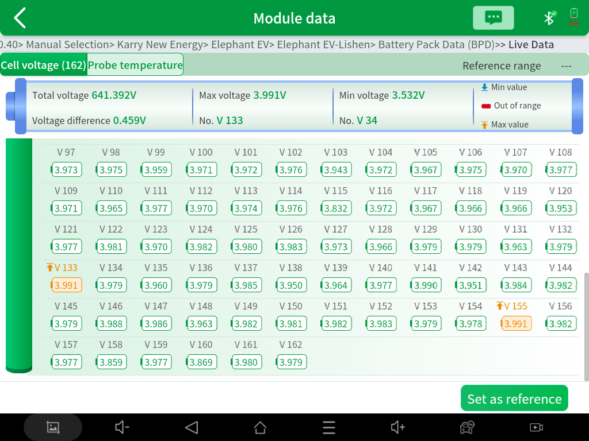
PART-03
FUNCTIONS
Battery pack detection
This function supports the detection of different types of battery packs for the mostly EV models on the market. It can read the individual cell‘s voltage and each single temperature probe data of the vehicle’s battery pack. It also allows checking the total voltage and the voltage of each cell in the battery pack and marks them with different colors according to their level and range. This helps you locate the fault cell faster.

Slide 16
PART-03
FUNCTIONS
Battery detection support list
No. | Car Make | No. | Car Make | No. | Car Make | No. | Car Make
1 | ACUR | 16 | GAC MIT | 31 | OPEL | 46 | TJSL
2 | AUDI | 17 | GM | 32 | PEUGEOT | 47 | TOYOTA
3 | BAIC | 18 | HONDA | 33 | PORSCHE | 48 | VOLKSWAGEN
4 | BEIJING HYUNDAI | 19 | HYUNDAI | 34 | PROMISE | 49 | VOLVO
5 | BENTLEY | 20 | KIA | 35 | RENAULT | 50 | WULING
6 | BENZ | 21 | LAMBORGHINI | 36 | SAIC GM | 51 | XIAOPANG
7 | BMW | 22 | LAND ROVER | 37 | SAIC VW | 52 | YUEDA KIA
8 | CHEVROLET | 23 | LEAP | 38 | SCION | 53 | ZHONGXIN
9 | CHRYSLER | 24 | LEXUS | 39 | SEAT | 54 | ZINORO
10 | CITROEN | 25 | LUXGEN | 40 | SKODA | Continue Updating
11 | CV VW | 26 | LYNK & CO | 41 | SKYWORTH
12 | FAW-VW | 27 | MAN | 42 | SMART
13 | FEIFAN | 28 | MINI | 43 | SUBARU
14 | FIAT | 29 | MIT | 44 | SUZUKI
15 | FORD | 30 | NISSAN | 45 | TESLA

Slide 17
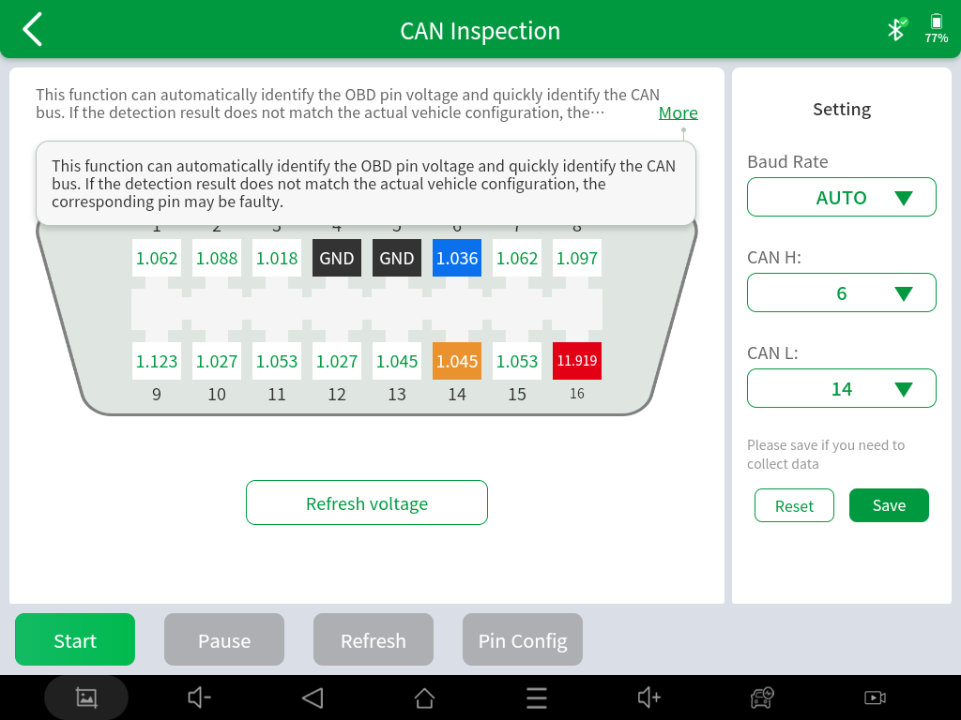
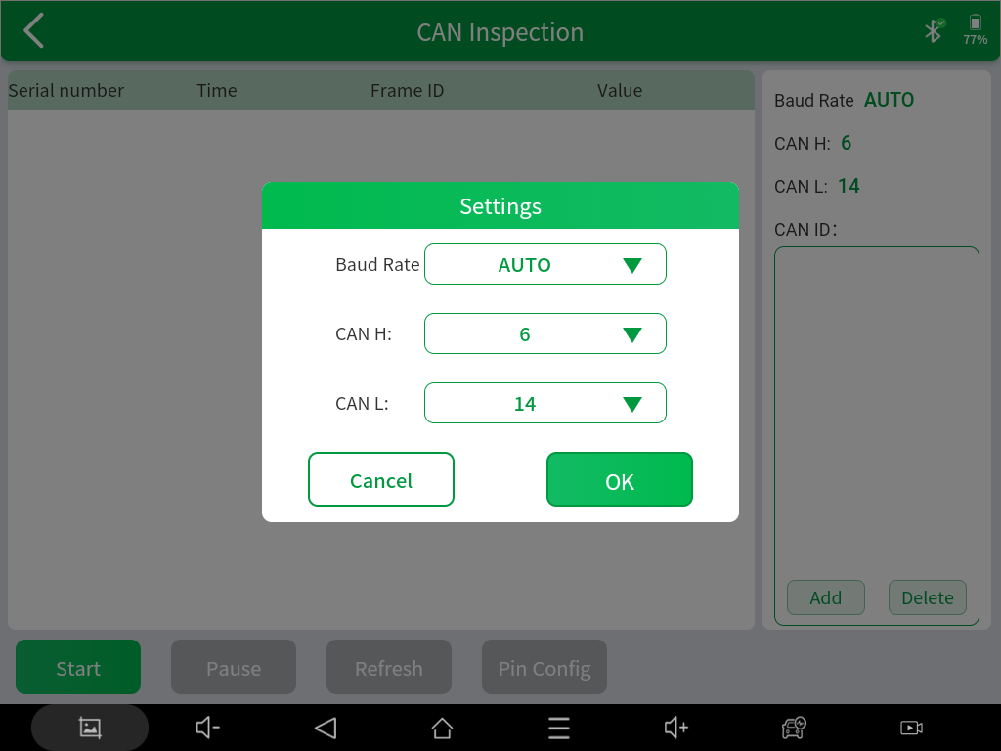
PART-03
FUNCTIONS
CAN Inspection
If the model of your battery pack is not covered, you can use the CAN INSPECTION function to collect data. It can detect the pin voltage and custom the pin configuration, and support to check the baud rate, can automatically identify the OBD pin voltage, and can quickly identify the CAN bus. If the detection results do not match the actual configuration, the corresponding pins may be faulty
Select the Pin Config to detect the voltage of pin
Click Start to confirm the settings and select OK to collect the data
Note: After data collection, please contact XTOOL Technical Support Center (supporting@xtooltech.com). We will update the battery detection coverage according to the data

Slide 18
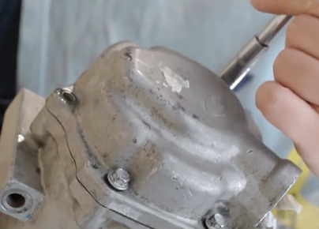
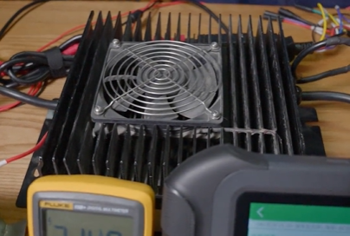
INTRODUCTION
PART-03
FUNCTIONS
01
AC Compressor Detection
This function supports the off-vehicle actuation test of the compressor module. After the compressor module is repaired, it does not need to be tested back on the vehicle. First, connect to the power supply according to the voltage identification on the compressor nameplate, and then connect to VCI according to the jumper diagram. By doing this, you can active the AC compressor.
02
OBC Detection
This function enables the off-vehicle actuation test of the OBC module. After the OBC module is repaired, it does not need to be tested back on the vehicle. First, connect the M812 box and VCI in series, and then connect the OBC and M812 box according to the jumper diagram. After connecting AC power to OBC, you can active OBC by one click.

Slide 19
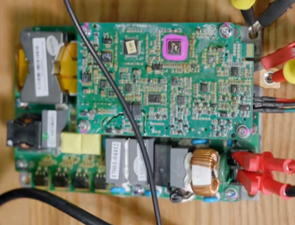
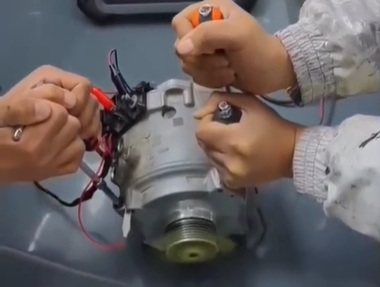
INTRODUCTION
PART-03
FUNCTIONS
03
DCDC Detection
This function realizes the off-vehicle actuation test of the DCDC module. After the DCDC module is repaired, it does not need to be tested back on the vehicle. After connecting to VCI according to the jumper diagram, you can drive DCDC by one click
04
48V Motor Detection
This function allows you to do the off-vehicle actuation test for Audi’s 48V motor module. After the 48V motor is repaired, it does not need to be tested back on the vehicle. Just connect the power supply and then connect to VCI according to the jumper diagram. This way, you can active motor by one click.

Slide 20
PART-04
COVERAGE-EV MODE
No. | Car Make | No. | Car Make |  | Car Make |  | Car Make |  | Car Make
1 | ACURA | 21 | DFPEUGEOT | 41 | GEELY | 61 | RENAULT | 81 | YQJC
2 | AUDI | 22 | DFTRUNK | 42 | SERES | 62 | RUICHI | 82 | YQSY
3 | BAOJUN | 23 | DFXK | 43 | JOYLONG | 63 | SAIC VW | 83 | YQVW
4 | BENTLEY | 24 | EMGRAND | 44 | KARRY | 64 | SKODA | 84 | YUEJIN
5 | BENZ | 25 | SOUEAST | 45 | KIA | 65 | SKYWELL | 85 | ZHIDOU
6 | BAIC | 26 | EXEED | 46 | KNDI | 66 | SMART | 86 | ZOTYE
7 | BMW | 27 | FQQT | 47 | LANDROVER | 67 | SAIC MAXUS | 87 | ZZNISSAN
8 | BQZZ | 28 | GM | 48 | LEXUS | 68 | TESLA
9 | BYD | 29 | TRUMPCHI | 49 | LIFAN | 69 | TJYQ
10 | CHANGAN | 30 | HNMAZDA | 50 | LEAPMOTOR | 70 | TOYOTA
11 | GREAT WALL AUTO | 31 | HONDA | 51 | LI AUTO | 71 | TRANSPORTER
12 | CHANGFENG | 32 | BRILLIANCE | 52 | LUXGEN | 72 | FORD
13 | CHERY | 33 | HUATAI | 53 | LYNKCO | 73 | VOLVO
14 | CHUANGWEI | 34 | HYUNDAI | 54 | MIT | 74 | VW
15 | CITROEN | 35 | INFINITI | 55 | NEZHA | 75 | NIO
16 | DACIA | 36 | IVECO | 56 | NISSAN | 76 | WM MOTOR
17 | DFCITROEN | 37 | JAC | 57 | NJJINLONG | 77 | WULING
18 | DFFS | 38 | JAGUAR | 58 | OPEL | 78 | XIAOPENG
19 | DFFX | 39 | JETOUR | 59 | PEUGEOT | 79 | YEMA
20 | DFJF | 40 | JMC | 60 | PORSCHE | 80 | YQAUDI

Slide 21
INTRODUCTION
PART-03
COVERAGE-General Mode
America |  | Asia |  |  |  | Europe
1 | BUICK | 17 | ACURA | 35 | NISSANG-TR | 52 | ABARTH | 70 | LANCIA
2 | CADILLAC | 18 | DAEWOO | 36 | PERODUA | 53 | ALPHA ROMEO | 71 | LANDROVER
3 | CHEVROLET | 19 | DAIHATSU | 37 | PROTON | 54 | ASTONMARTIN | 72 | MASERATI
4 | CHRYSLER | 20 | HONDA | 38 | RENAULT SAMSUNG | 55 | AUDI | 73 | MAYBACH
5 | DODGE | 21 | HOLDEN | 39 | SSANGYONG | 56 | BAOWO | 74 | OPEL
6 | GM | 22 | HYUNDAI | 40 | SUBARU | 57 | BENTLEY | 75 | PEUGEOT
7 | GMC | 23 | HYUNDAI CV | 41 | SUZUKI | 58 | BENZ | 76 | PORSCHE
8 | FORD | 24 | INFINITI | 42 | TATA | 59 | BENZ SMART | 77 | RENAULT
9 | HUMMER | 25 | ISUZU | 43 | TH ISUZU | 60 | BENZ TRANSPORTER | 78 | ROLLS ROYCE
10 | JEEP | 26 | ISUZU LIGHT TRUCK | 44 | TOYOTA | 61 | BMW | 79 | SEAT
11 | LINCOLN | 27 | KIA | 45 | VINFAST | 62 | BMW MINI | 80 | SKODA
12 | PONTIAC | 28 | LEXUS | 46 | ZHONGHUA | 63 | BUGATTI | 81 | VOLVO
13 | SAAB | 29 | LUXGEN | Russia |  | 64 | CITROEN | 82 | VW
14 | SATURN | 30 | MAHINDRA | 47 | GAZ | 65 | DACIA | 83 | VW CV
15 | SCION | 31 | MARUTI | 48 | PAZ | 66 | FERRARI | Next page
16 | TESLA | 32 | MAZDA | 49 | UAZ | 67 | FIAT
17 | VAUXHALL | 33 | MITSUBISHI | 50 | VAZ | 68 | JAGUAR
 |  | 34 | NISSAN | 51 | ZAZ | 69 | LAMBORGHINI

Slide 22
INTRODUCTION
PART-03
COVERAGE-General Mode
China
84 | BAIC AUTOMOBILE | 104 | CHANGFENG LIEBAO | 121 | FAW AUDI | 142 | HAFEI AUTOMOBILE | 162 | SAIC BUICK | 180 | WEICHAI POWER
85 | BAIC BENZ | 105 | CHANGHE AUTOMOBILE | 122 | FAW CAR | 143 | HAIMA AUTOMOBILE | 163 | SAIC CADILLAC | 181 | WEICHAI YINGZHI
86 | BAIC HUANSU | 106 | CHERY AUTOMOBILE | 123 | FAW ERFA | 144 | HUATAI AUTOMOBILE | 164 | SAIC CHEVROLET | 182 | YUEDA KIA
87 | BAIC HYUNDAI | 107 | CHERY KARRY | 124 | FAW HONGTA | 145 | JAC | 165 | SAIC CHEVROLET SPARK | 183 | YUEJIN AUTOMOBILE
88 | BAIC JEEP | 108 | CHERY KARRY PICKUP | 125 | FAW JIA BAO | 146 | JAC LIGHT TRUCK | 166 | SAIC GENERAL | 184 | YUTONG LIGHT TRUCK
89 | BAIC MANUFACTURING | 109 | CHERY RIICH | 126 | FAW JILIN LIGHT TRUCK | 147 | JAC REFINE | 167 | SAIC GM WULING | 185 | ZHENGZHOU NISSAN
90 | BAIC MICROCAR | 110 | CHONGQING QINGLING | 127 | FAW MAZDA | 148 | JETOUR | 168 | SAIC MAXUS | 186 | ZHIDOU AUTOMOBILE
91 | BAIC SENOVA | 111 | DONGFENG CITROEN | 128 | FAW TOYOTA | 149 | JINKANG (SERES) | 169 | SAIC MG | 187 | ZHONGXING AUTOMOBILE
92 | BAOJUN AUTOMOBILE | 112 | DONGFENG FENGGUANG | 129 | FAW XENIA | 150 | JMC | 170 | SAIC ROEWE | 188 | ZOTYE AUTOMOBILE
93 | BAOLONG | 113 | DONGFENG FENGSHEN | 130 | FAW-VOLKSWAGEN | 151 | JMC LIGHT TRUCK | 171 | SAIC SKODA
94 | BRILLIANCE BMW | 114 | DONGFENG FENGXING | 131 | FOTON LIGHT TRUCK | 152 | JOYLONG MOTOR | 172 | SAIC VOLKSWAGEN
95 | BRILLIANCE JINBEI | 115 | DONGFENG HONDA | 132 | GAC FIAT | 153 | KEYTON | 173 | SAIC WEIWANG
96 | BRILLIANCE XINYUAN | 116 | DONGFENG LIGHT TRUCK | 133 | GAC MITSUBISHI | 154 | KONKA | 174 | SICHUAN YEMA
97 | BRITISH MOTOR | 117 | DONGFENG MICRO | 134 | GAC QOROS | 155 | LIFAN | 175 | SOUTHEAST AUTOMOBILE
98 | BYD | 118 | DONGFENG NISSAN | 135 | GAC TOYOTA | 156 | LYNK & CO | 176 | SUZUKI CHANGHE
99 | CHANGAN AUTOMOBILE | 119 | DONGFENG PEUGEOT | 136 | GEELY AUTOMOBILE | 157 | NANJING FIAT | 177 | TIANJIN FAW
100 | CHANGAN COMMERCIAL | 120 | DONGFENG XIAOKANG | 137 | GEELY EMGRAND | 158 | NANJING IVECO LIGHT TRUCK | 178 | TRUMPCHI
101 | CHANGAN FORD |  |  | 138 | GEELY EXEED | 160 | AUX | 179 | VENUCIA
102 | CHANGAN KUAYUE |  |  | 139 | GEO AUTO | 161 | QINGLING LIGHT TRUCK
103 | CHANGAN SUZUKI |  |  | 140 | GREAT WALL MOTOR
 |  |  |  | 141 | GUANGQI HONDA

Slide 23
PRODUCT
TRAINING
2022-10-27
04
Packing List
Basic executive training

Slide 24
PART-03
PACKING LIST
Category | No. | Name | QTY
Test connector | 1 | DB15 to OBD2-16 Main Cable | 1
 | 4 | TESLA Battery Pack Adapter J1E04 | 1
 | 5 | TESLA LAN Adapter 1-L1E02 | 1
 | 6 | TESLA CAN Adapter 2-L1E03 | 1
 | 7 | Universal Jumper Cables | 1
 | 8 | Universal Jumper Adapter | 1
 | 9 | Cigar Lighter | 1
Host group | 1 | Tablet | 1
 | 2 | VCI Box | 1
 | 3 | Type-C to Type-B Cable (Connect to VCI) | 1
 | 4 | Type-C to Type-A Cable (Connect to PC) | 1
 | 5 | Type-C to Type-C Charger Cable | 1
 | 6 | Power Supply Charger Adapter US | 1
 | 7 | Charger Cable EU | 1
 | 8 | Charger Cable UK | 1
Accessories | 1 | Color Carton | 1
 | 2 | Packing List | 1
 | 3 | Tool Case | 1
 | 4 | Quick Start Guide | 1
 | 5 | Certificate of Quality | 1

Slide 25
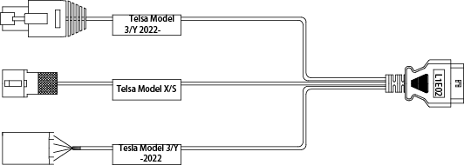
PART-04
TESLA ADAPTER
L1E02 - TESLA LAN Diagnostic Adapter
L1E02 supports reading live data, reading and clearing DTC, which needs to be used with Type-C to Type-B cable and cigarette lighter cable.

Slide 26
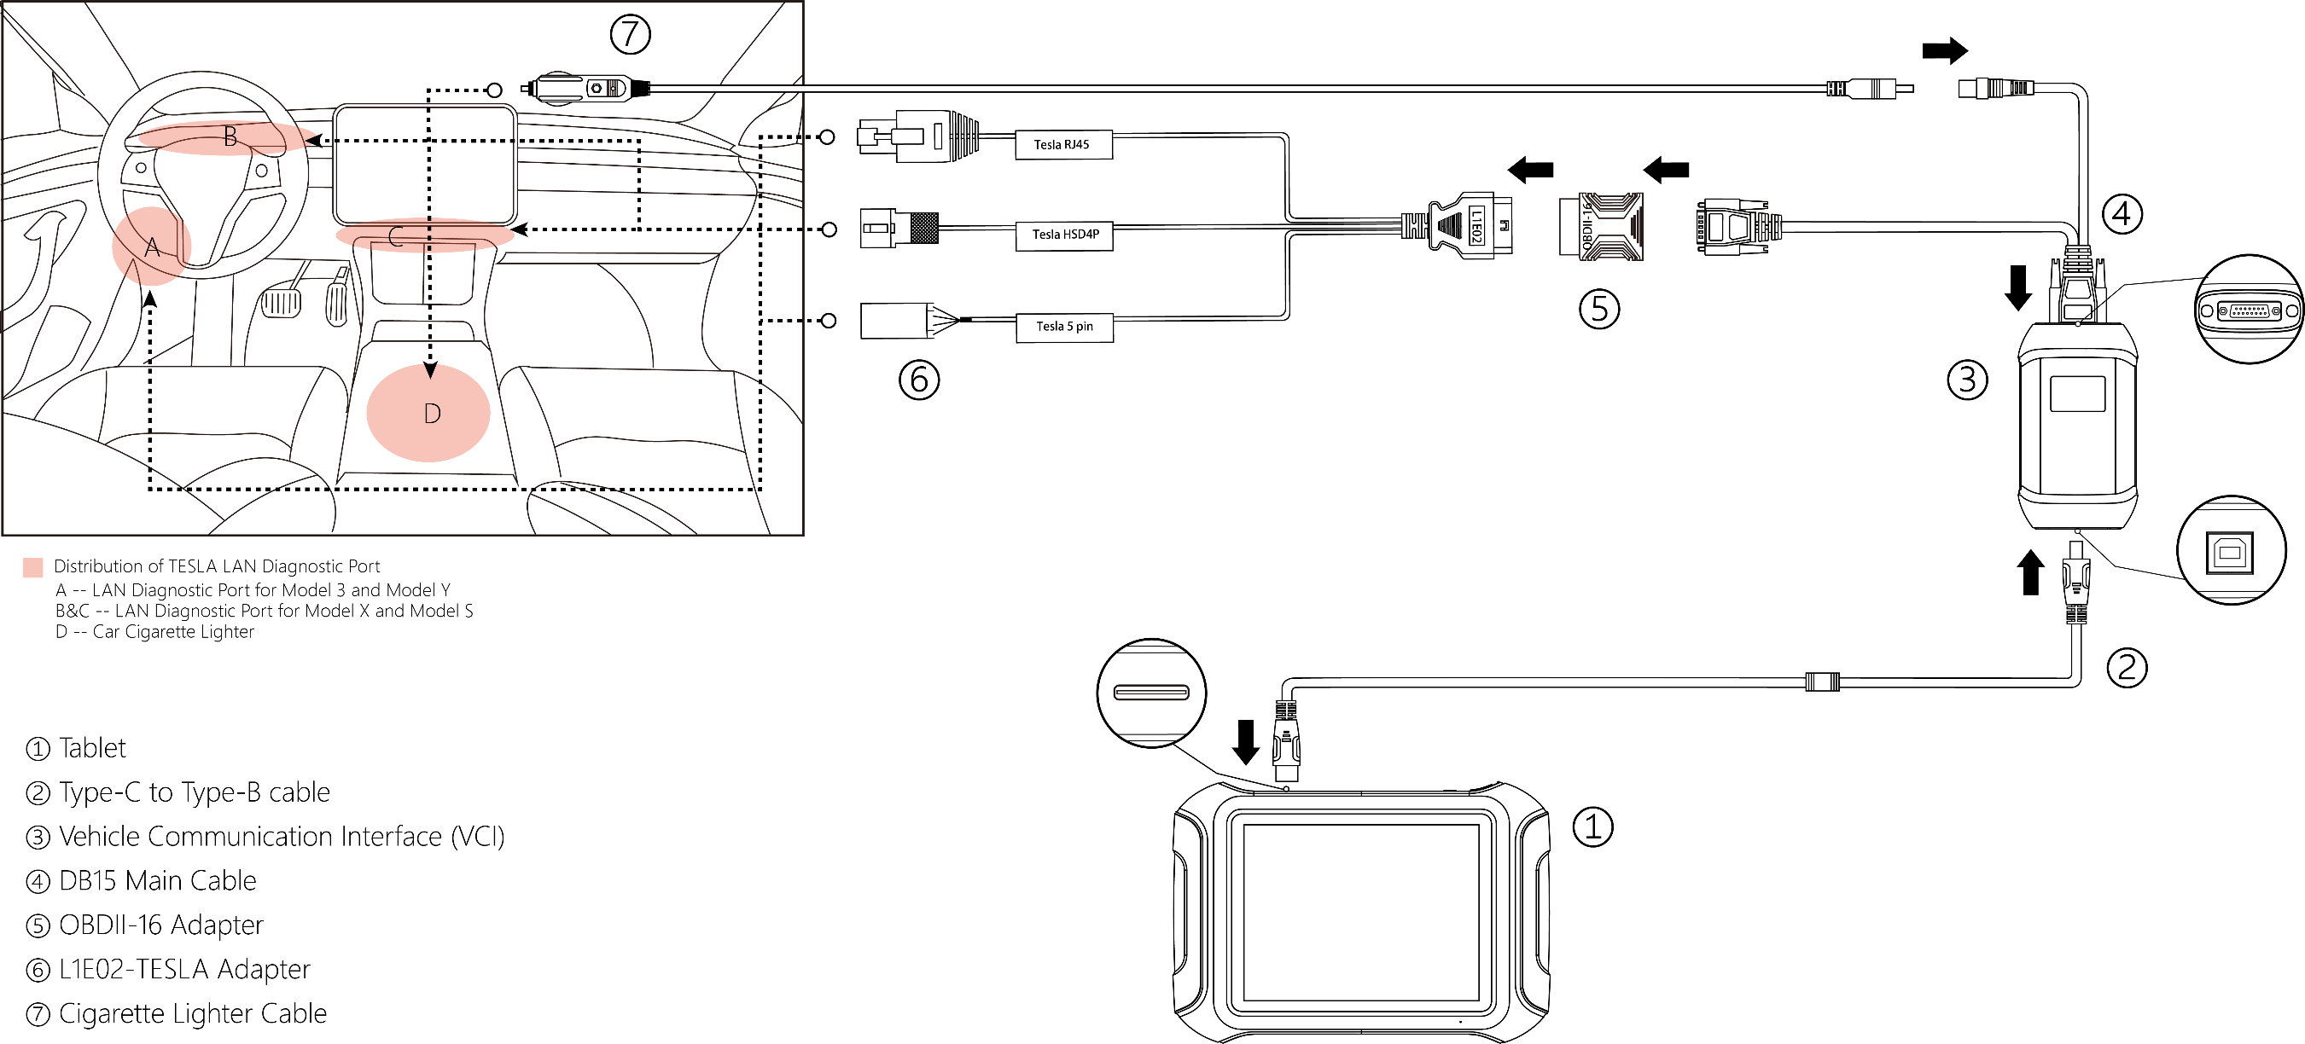
PART-04
TESLA ADAPTER
L1E02 - Connection Diagram

Slide 27
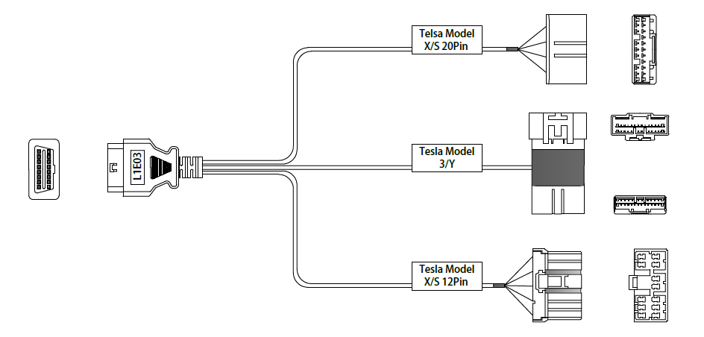
PART-04
TESLA ADAPTER
L1E03 - TESLA CAN Diagnostic Adapter
L1E03 supports directly reading of single cell voltages for TESLA

Slide 28
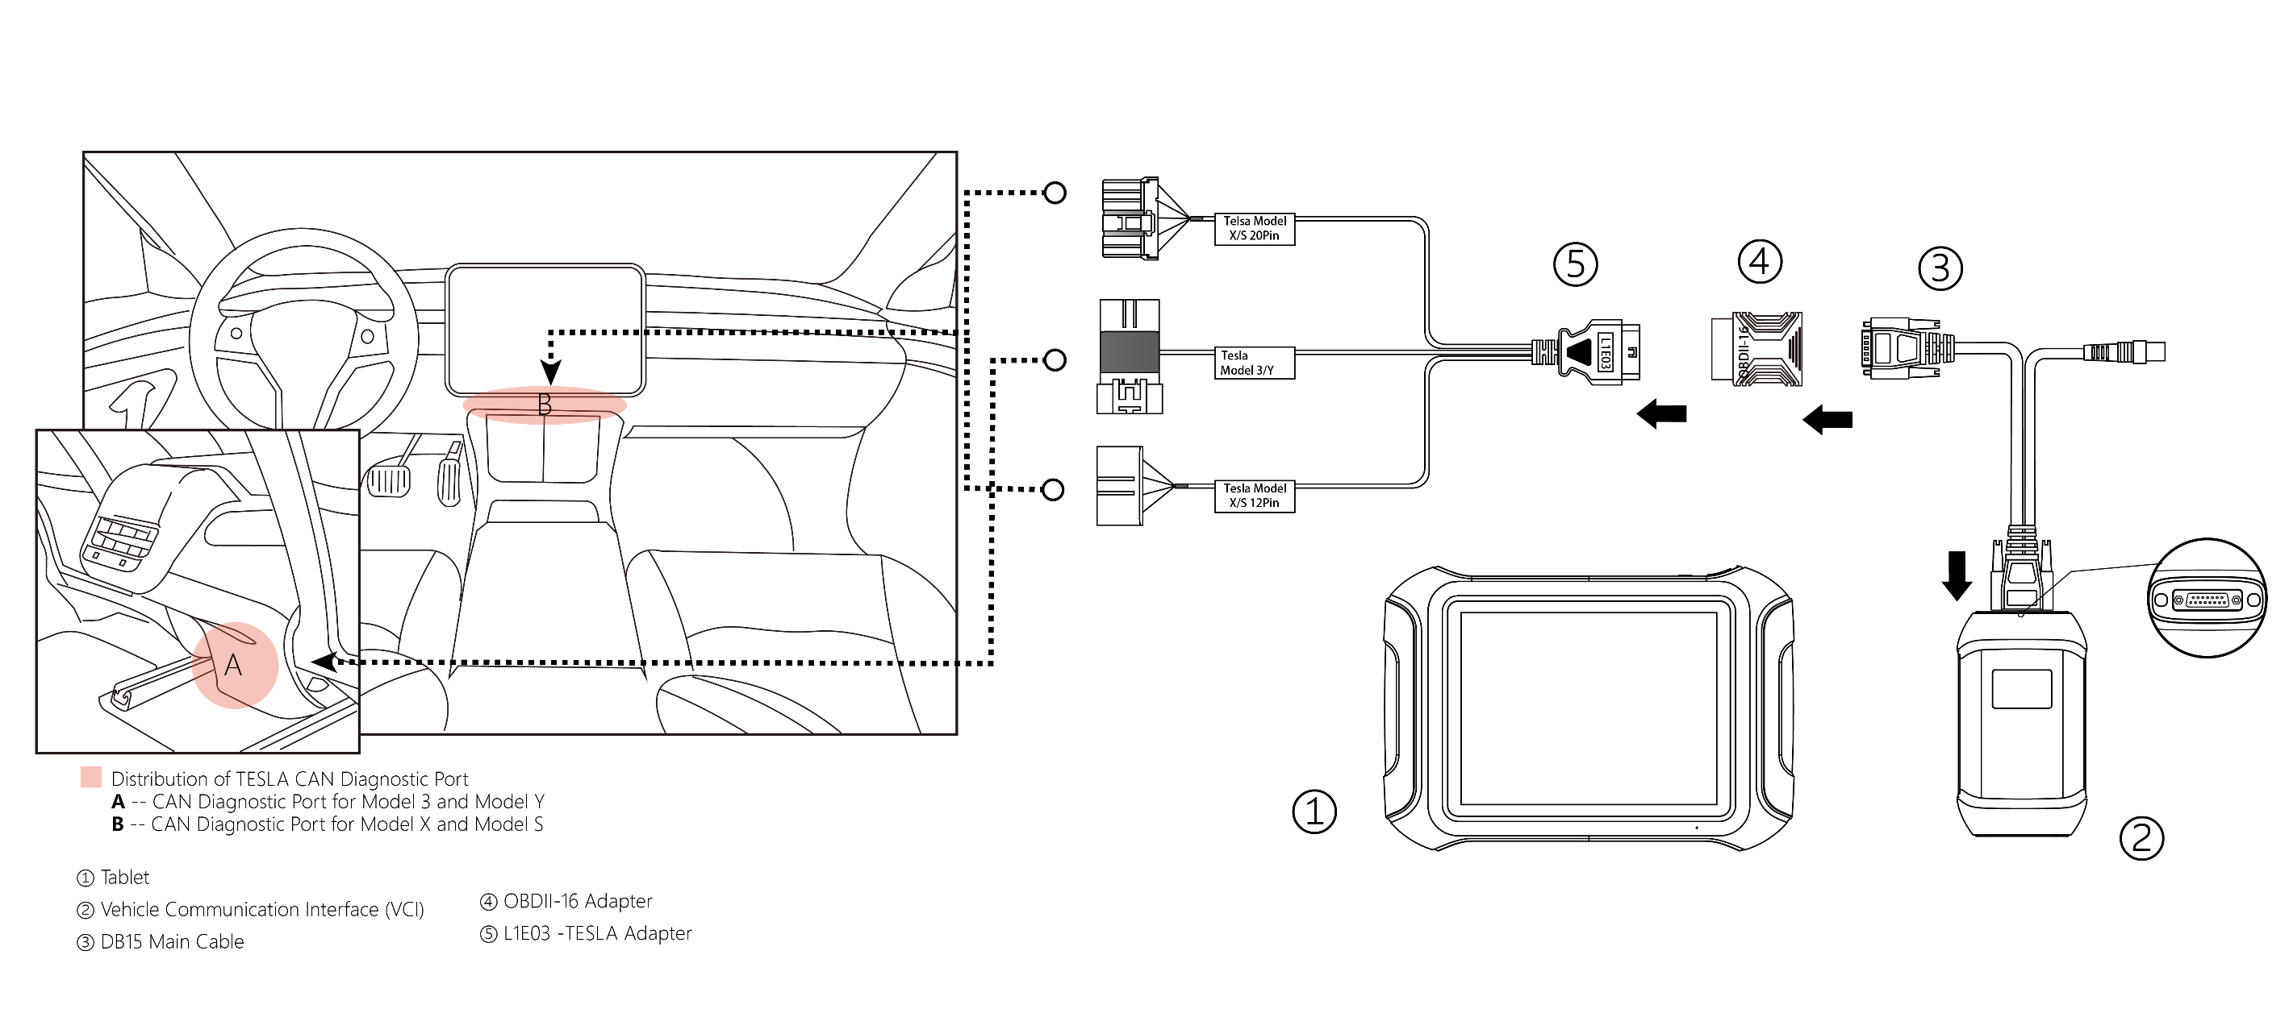
PART-04
TESLA ADAPTER
L1E03 - Connection Diagram

Slide 29

PART-04
TESLA ADAPTER
J1E04 - TESLA Battery Adapter
J1E04 supports direct reading of single cell voltages for TESLA Model 3/Y

Slide 30
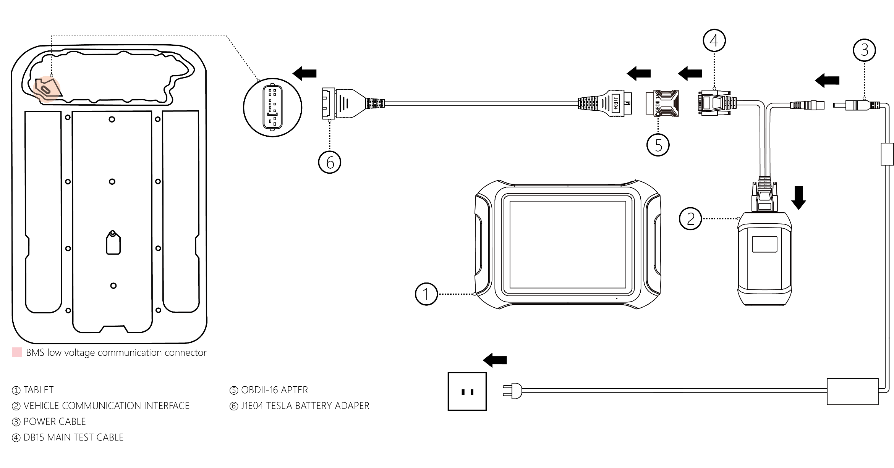
PART-04
TESLA ADAPTER
J1E04 – Connection Diagram

Slide 31
PRODUCT
TRAINING
2022-10-27
Thanks for watching
Shenzhen Xtooltech Intelligent Co., Ltd.
2022-10-27
Basic executive training

